Slide 1


ADICHUNCHANAGIRI INSTITUTE OF TECHNOLOGY (Affiliated to Visvesvaraya Technological University, Belagavi, Approved by AICTE and Accredited by NAAC)
CHIKKAMAGALURU-577102
DEPARTMENT OF COMPUTER SCIENCE & ENGINEERING
TECHNICAL SEMINAR ON
“SMART AND ADAPTIVE STREET LIGHT WITH SAFETY SYSTEM”
UNDER THE GUIDANCE OF : Mrs. Keerthishree B.T. B.E., M.Tech.
Assistant Professor,
Department of CS&E.
PRESENTED BY :
Amulya N Raj (4AICS009)
8th Semester, Department of Computer Science & Engineering.

Slide 2
Abstract
The project is implemented with smart system that controls the street light based on detection of sunlight.
During the night time the street light gets automatically ON and during the day time it gets automatically OFF.
A camera is placed on top of the street light to track the actions performed on the road.
In addition to this, a panic button is placed on the pole, in-case of any emergency or danger, the person in danger can press this button which raises an alarm at the nearby police station.
DEPARTMENT OF COMPUTER SCIENCE AND ENGINEERING, A.I.T., CHIKKAMAGALURU.

Slide 3
Contents
Introduction
Problem Statement
Design and Implementation
System Requirement
Methodology
Implementation
Results
Conclusion
References
DEPARTMENT OF COMPUTER SCIENCE AND ENGINEERING, A.I.T., CHIKKAMAGALURU.

Slide 4
Introduction
The largest expense of a city is mainly because of street lights. The cost spent is huge that all the sodium vapour lamps consume more power.
Currently a manual system is used where the light will be made to switched ON/OFF i.e the light will be made to switched ON in the evening and switched OFF in the morning. Hence there is a lot of energy wastage between the ON/OFF.
Hence smart street light can be used to cut the municipal waste and mainly used to track the crimes happening at the road using panic button and camera and to prevent energy improvidence.
When an emergency situation like theft, harassment is found to happen but sound is not detected, a panic button is provided at the reachable height which can be pressed by the person whoever seeing that incident.
DEPARTMENT OF COMPUTER SCIENCE AND ENGINEERING, A.I.T., CHIKKAMAGALURU.

Slide 5
Problem Statement
The street light is one of the huge expenses in a city. The cost spent is huge that all the sodium vapour lamps consume more power. Instead we use light emitting diode(LED). With the rise of deep learning, it is important to develop effective methods to overcome.
Input : A dataset of real images of sunlight has been collected. The dataset should be large and diverse, sensors to detect sunlight and sound.
Process:
1. Data Collection: Gathering a large and diverse dataset of real images of objects with the help of camera that is used for training and testing the deep learning model.
2. During the training phase, the deep learning models will learn the features and patterns, they target the objects.
3. During the testing phase, the images with or without objects undergoes for testing.
Output: Based on the sunlight and objects presence smart street lights changes intensity of light.
Smart poles are connected with camera will detect various abnormal activities occur on road like accidents, harassment etc.. when it happens sound will be detected with the help of inbuilt mike in camera and camera will turn towards the detected sound and will send live footage to the control room.
DEPARTMENT OF COMPUTER SCIENCE AND ENGINEERING, A.I.T., CHIKKAMAGALURU.

Slide 6
System Requirements
Hardware Requirements:
LED
LDR Sensor
PIR Sensor
Panic button
Software Requirement:
Operating System : Windows 10
Coding Language : Python
Package : TensorFlow , Speech Recognition , OPENCV
DEPARTMENT OF COMPUTER SCIENCE AND ENGINEERING, A.I.T., CHIKKAMAGALURU.

Slide 7
Methodology
The main objectives of the project are as follows:
Objective 1: Automatic ON and OFF mechanism and automated intensity control of street lights using LDR and sensors.
Objective 2: Implementation of security devices like camera with inbuilt mic and panic button.
DEPARTMENT OF COMPUTER SCIENCE AND ENGINEERING, A.I.T., CHIKKAMAGALURU.

Slide 8
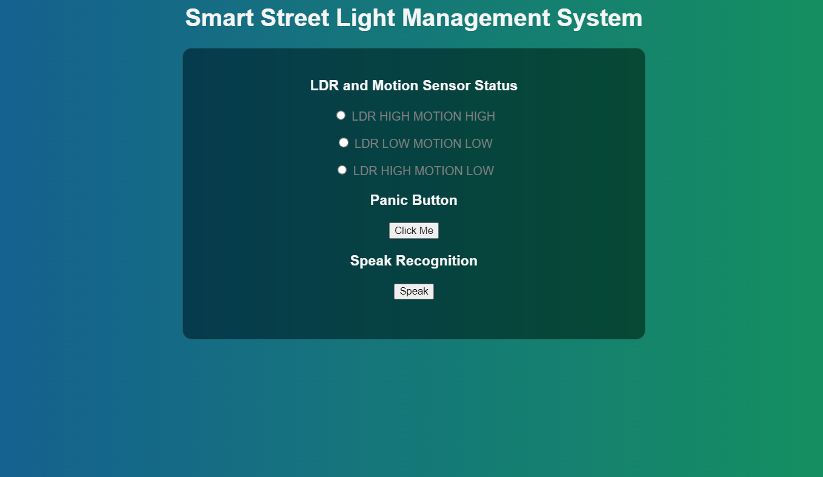
Fig: Home Page of Smart Street Light
DEPARTMENT OF COMPUTER SCIENCE AND ENGINEERING, A.I.T., CHIKKAMAGALURU.

Slide 9
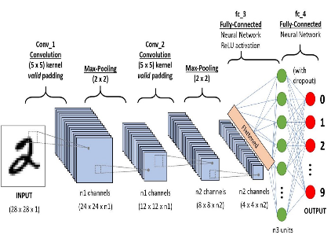
Implementation
CNN algorithm:
Image dataset Working in CNN
DEPARTMENT OF COMPUTER SCIENCE AND ENGINEERING, A.I.T., CHIKKAMAGALURU.

Slide 10
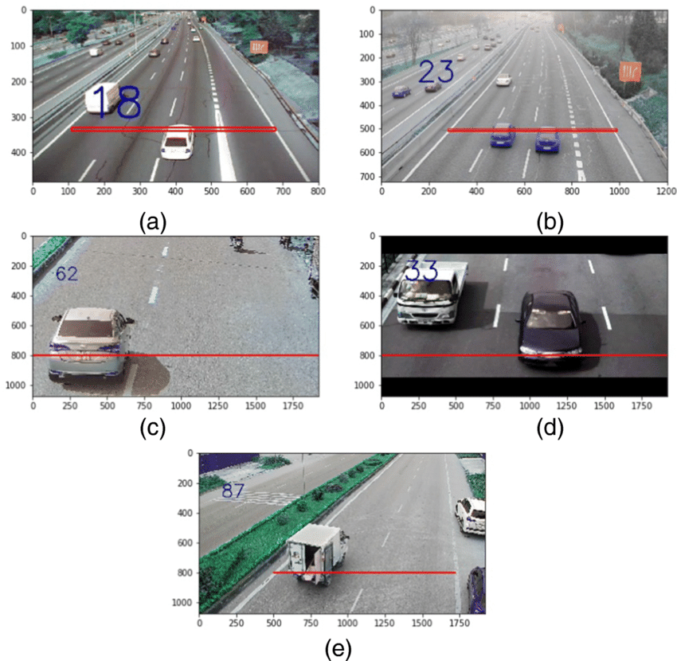
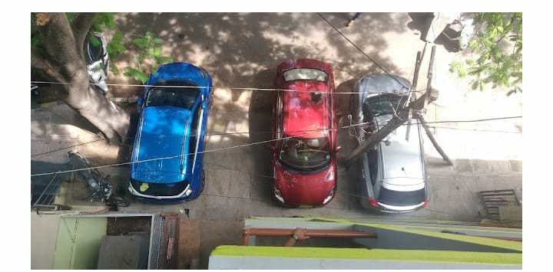
Data collection
The dataset is collected from “ Kaggle.com ” website.
(e)
Fig: Dataset collection
DEPARTMENT OF COMPUTER SCIENCE AND ENGINEERING, A.I.T., CHIKKAMAGALURU.

Slide 11
Convolution Neural network
Convolutional Neural Network (CNN) is a class of deep neural networks which is applied for analyzing visual imagery.
Convolution preserves the relationship between pixels by learning image features using small squares of input data.
It is a mathematical operation that takes two inputs such as image matrix and a filter or kernel.
Each input image will be passed through a series of convolution layers with filters (kernels) to produce output feature maps.
DEPARTMENT OF COMPUTER SCIENCE AND ENGINEERING, A.I.T., CHIKKAMAGALURU.

Slide 12
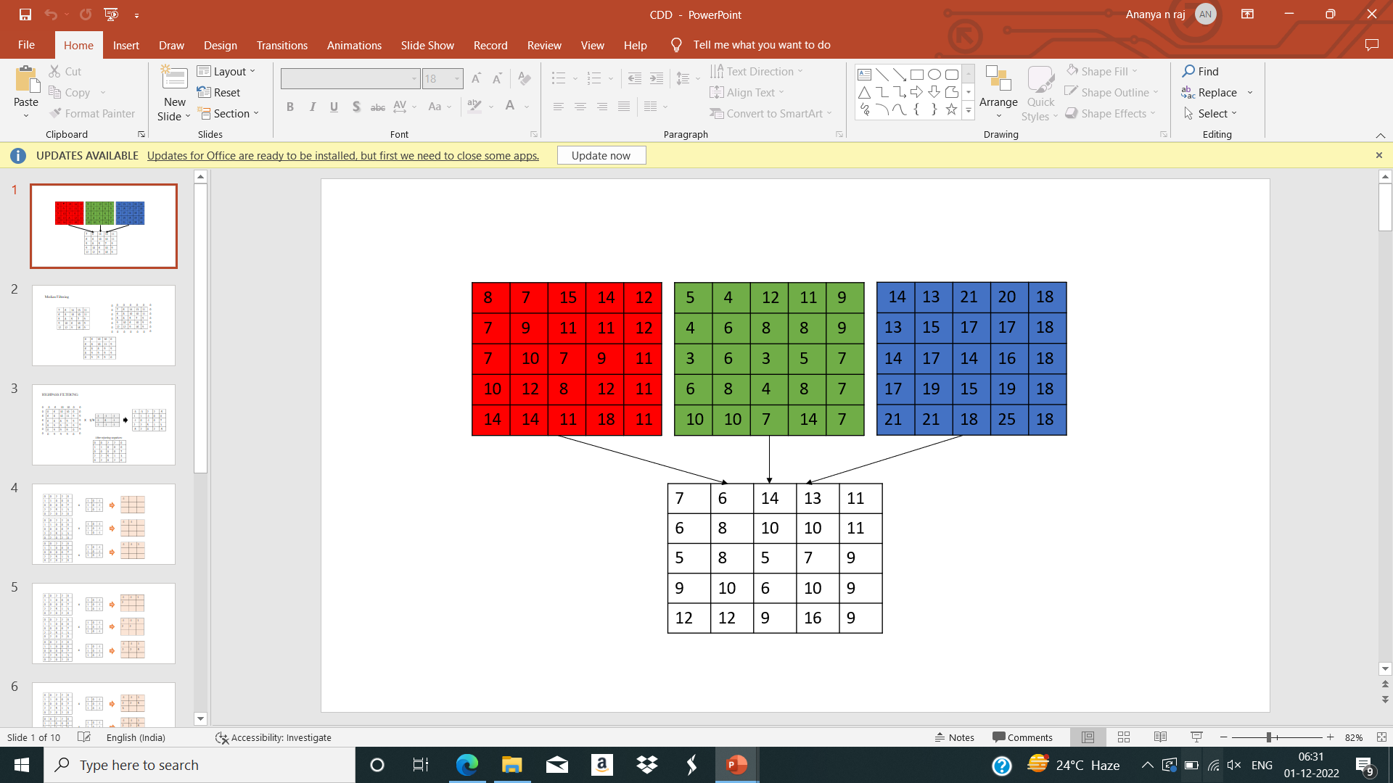
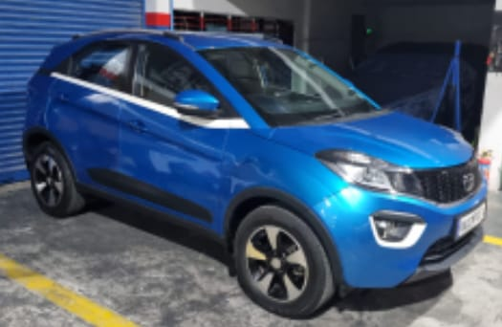
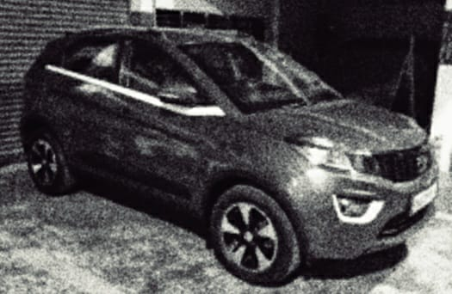
RGB to grey scale conversion
The formula:0.2989*R+0.5870*G+0.1140*B
Original Image :
Grey Image :
DEPARTMENT OF COMPUTER SCIENCE AND ENGINEERING, A.I.T., CHIKKAMAGALURU.

Slide 13
Data Resize
Resizing allows to make the image smaller or larger without cutting anything out.
Resizing alters the image's dimensions.
The most common reason for resizing photos is to reduce the size of large files to make them easier to insert into the machine.
DEPARTMENT OF COMPUTER SCIENCE AND ENGINEERING, A.I.T., CHIKKAMAGALURU.

Slide 14

Median filtering
NOISE REMOVAL
Original matrix:
Append 0’s at edges and corners :
enhanced matrix :
DEPARTMENT OF COMPUTER SCIENCE AND ENGINEERING, A.I.T., CHIKKAMAGALURU.

Slide 15
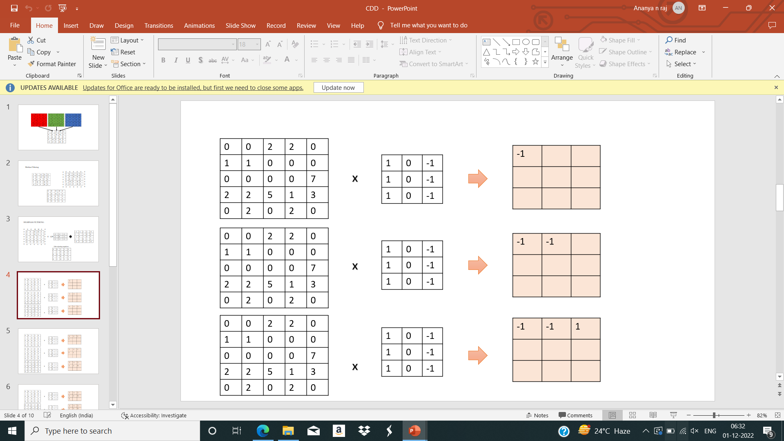
Convolution Layer
DEPARTMENT OF COMPUTER SCIENCE AND ENGINEERING, A.I.T., CHIKKAMAGALURU.

Slide 16
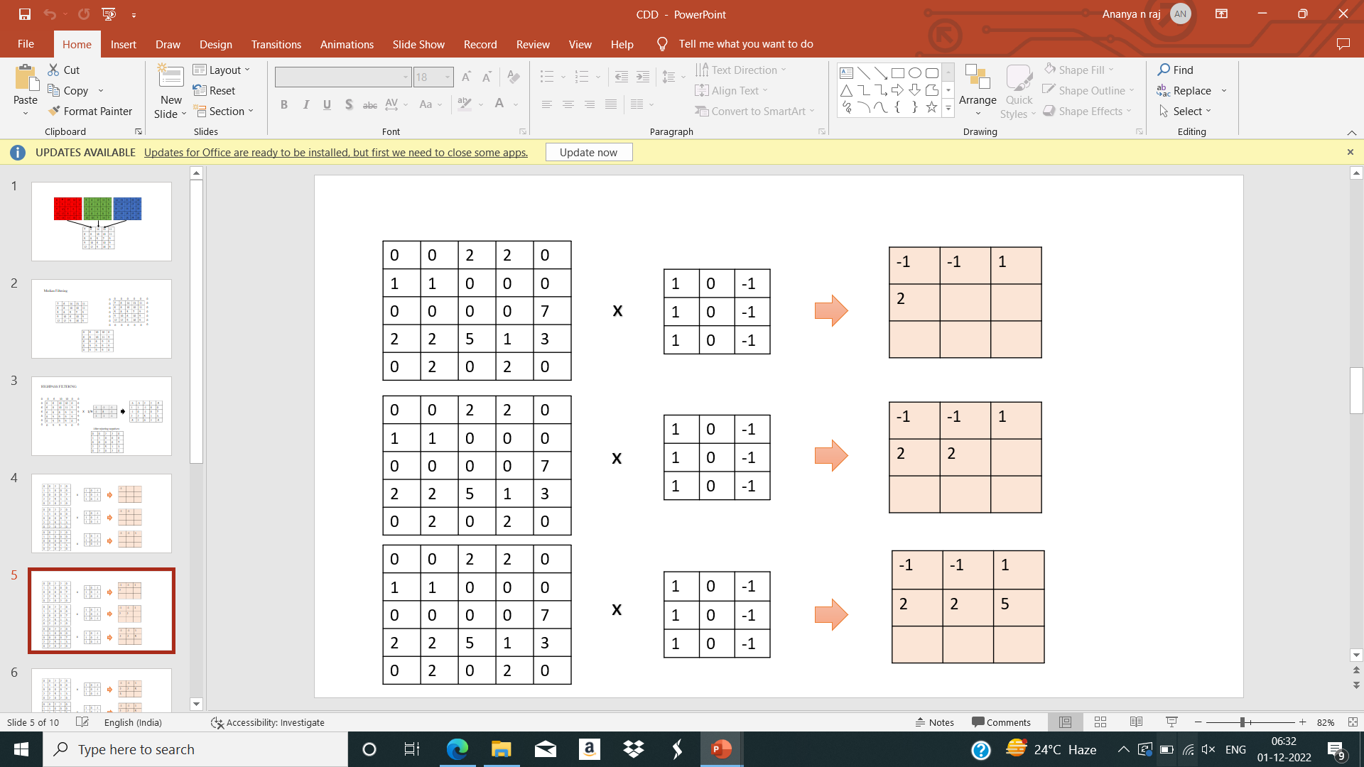
CONVOLUTION LAYER CONT.,
DEPARTMENT OF COMPUTER SCIENCE AND ENGINEERING, A.I.T., CHIKKAMAGALURU.

Slide 17
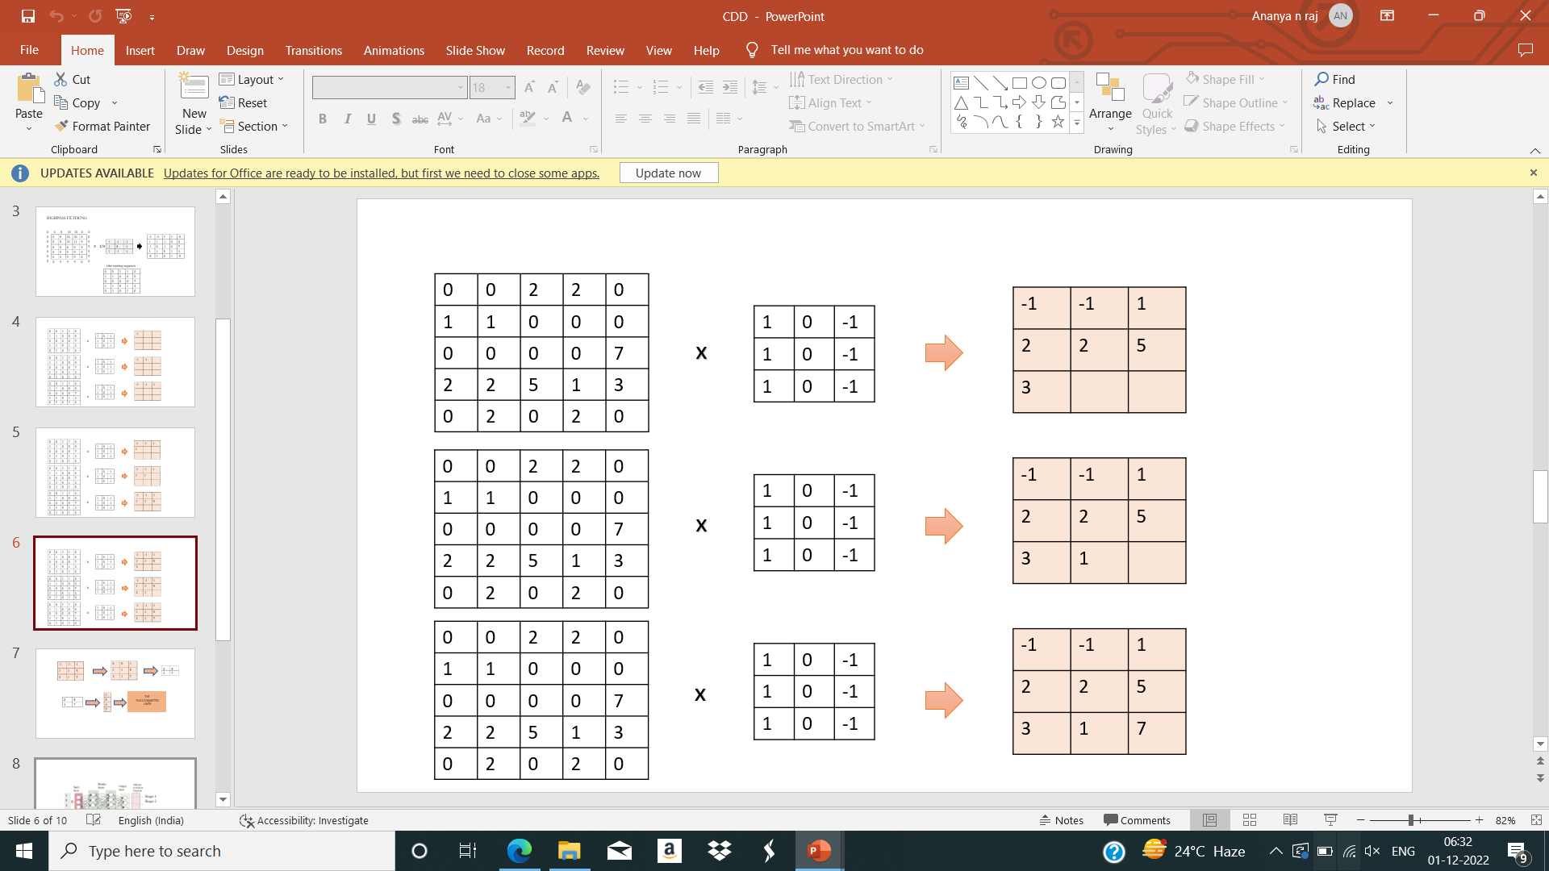
CONVOLUTION LAYER CONT.,
DEPARTMENT OF COMPUTER SCIENCE AND ENGINEERING, A.I.T., CHIKKAMAGALURU.

Slide 18
Relu layer
ReLU layer is nothing but the rectified linear unit, in this layer we remove every negative value from the filtered images and replaces it with zero.
This is done to avoid the values from summing up to zeroes.
This is a transform function which activates a node only if the input value is above a certain number while the input is below zero the output will be zero then remove all the negative values from the matrix.
DEPARTMENT OF COMPUTER SCIENCE AND ENGINEERING, A.I.T., CHIKKAMAGALURU.

Slide 19
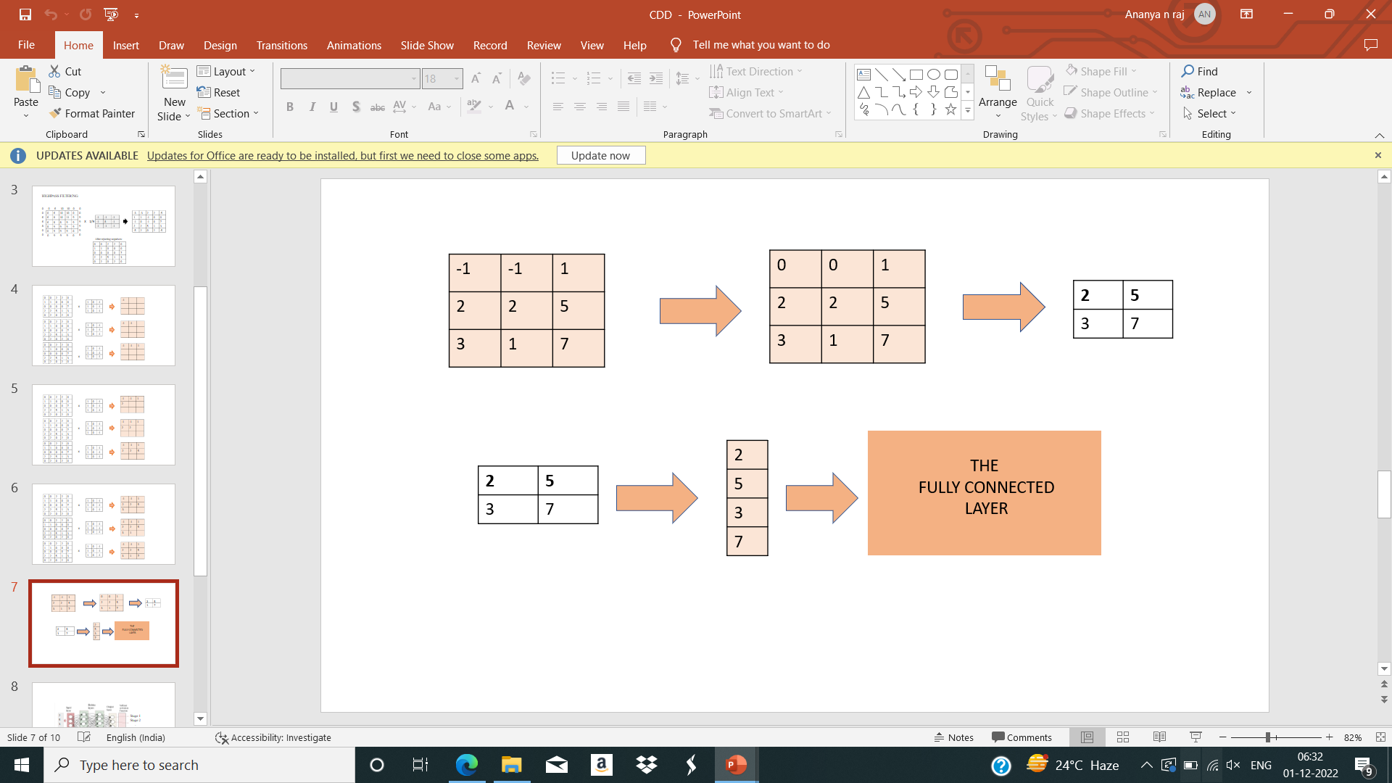
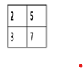


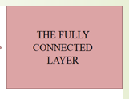
POOLING LAYER FULLY CONNECTED LAYER
2
5
3
Pooling Layer
[MAX Pooling]
Pooled output:A
2*2 matrix
From Pooling Layer
7
ReLu Layer
Flattened Matrix
DEPARTMENT OF COMPUTER SCIENCE AND ENGINEERING, A.I.T., CHIKKAMAGALURU.

Slide 20

Results and Analysis
1. Motion detection for balancing intensity of street light
1.1 LDR high and motion high
The street light automatically gets ON when the LDR is high and motion is detected.
Snapshot 1: LDR high motion high
DEPARTMENT OF COMPUTER SCIENCE AND ENGINEERING, A.I.T., CHIKKAMAGALURU.

Slide 21
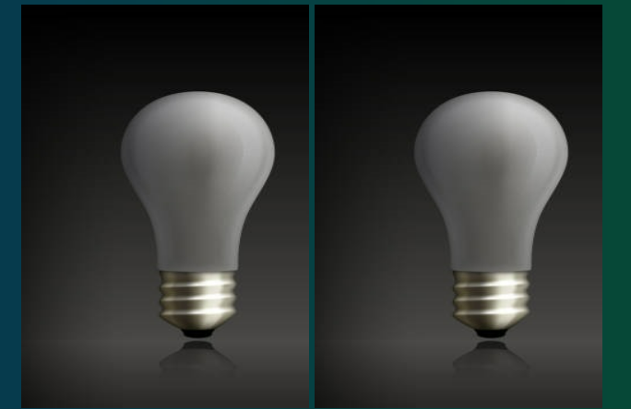
1.2 LDR low and motion low
The street light automatically gets OFF when it sense LDR low and no motion is detected.
Snapshot 2: LDR low motion low
DEPARTMENT OF COMPUTER SCIENCE AND ENGINEERING, A.I.T., CHIKKAMAGALURU.

Slide 22

1.3. LDR high and motion low
Alternative street light gets ON when LDR is high and no motion is detected. Hence the energy can be saved.
Snapshot 3: LDR high motion low
DEPARTMENT OF COMPUTER SCIENCE AND ENGINEERING, A.I.T., CHIKKAMAGALURU.

Slide 23
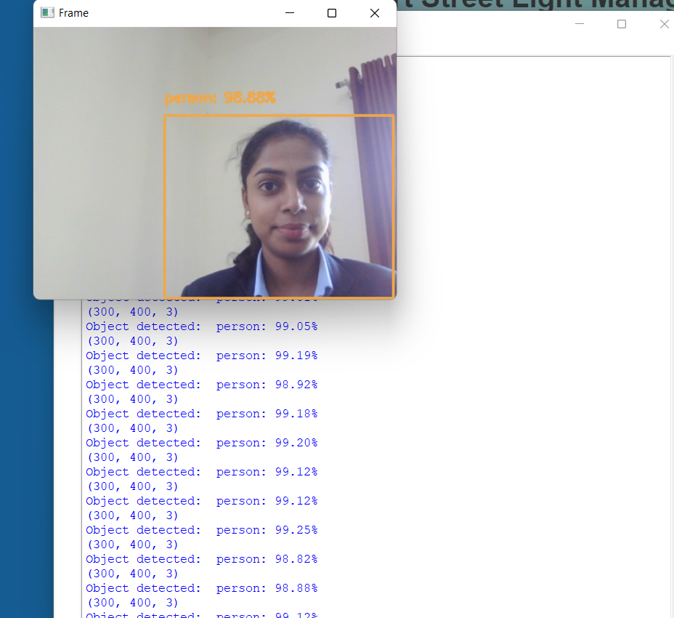
2. Detection and capturing of abnormal activities on street through panic button.
If a panic button is pressed in case of emergency it sends the message and live footage to the near by police control room through an e-mail.
Snapshot 4: Video recording when a panic button is pressed.
DEPARTMENT OF COMPUTER SCIENCE AND ENGINEERING, A.I.T., CHIKKAMAGALURU.

Slide 24
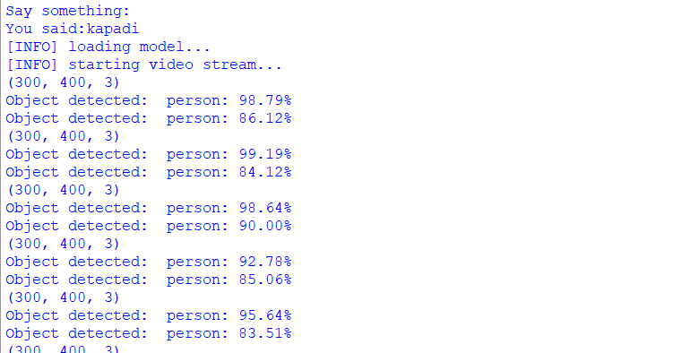
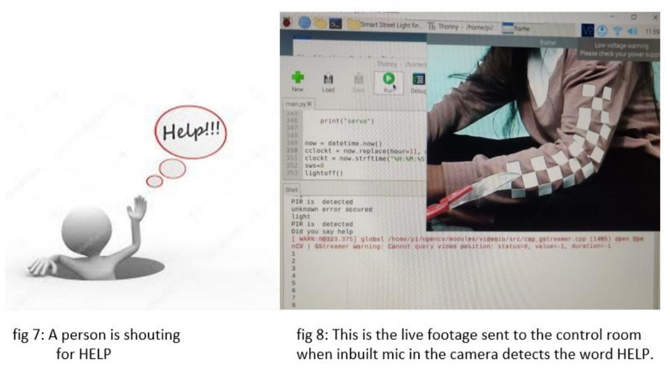
3. Detection and capturing of abnormal activities on street through speech recognition.
Speech recognition, also called as Automatic speech recognition (ASR), computer speech recognition or speech-to-text, is a capability which enables a programmer software to process human speech into written format.
Fig: A person shouting for HELP
Snapshot 5: Sent message can be seen.
DEPARTMENT OF COMPUTER SCIENCE AND ENGINEERING, A.I.T., CHIKKAMAGALURU.

Slide 25

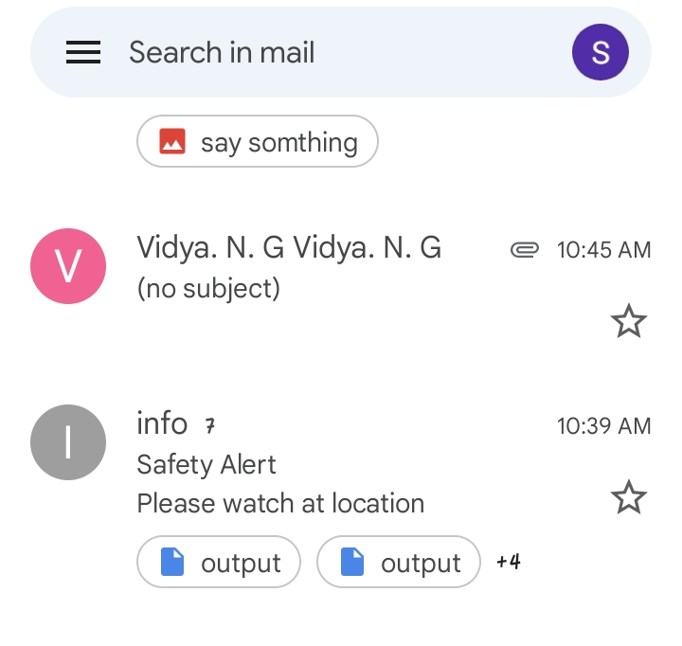
Snapshot 6: This is the live footage sent to police via mail.
DEPARTMENT OF COMPUTER SCIENCE AND ENGINEERING, A.I.T., CHIKKAMAGALURU.

Slide 26
Conclusion
The system cuts down the cost of conventional system by 50-60 percent which improves the economy of the country and saves a huge amount of investment as it can be utilized in useful ideas.
The system ensures the security to the people and it provides a great security.
The system can prevent women harassment, thefts and other threats.
The system is Cost efficient, Reliable, Wireless communication, Prevents manual ON and OFF of street lights, Prevents energy wastage, Ecofriendly and the safest way to save energy .
DEPARTMENT OF COMPUTER SCIENCE AND ENGINEERING, A.I.T., CHIKKAMAGALURU.

Slide 27
Applications
Dynamic lighting control based on movement detection
Digital signage that can update as needed, such as detecting abnormal activities like accidents etc.
Sensors that senses the voice will help recording any abnormal activities on road.
Monitor and track live footages of activities on road.
Street lighting controls reduces energy consumption and carbon dioxide emission.
Street lighting control lowers repair and maintainance cost with the monitoring software reduces carbon emmision and pollution
It will increases lamp life and shorter response times to outages.
DEPARTMENT OF COMPUTER SCIENCE AND ENGINEERING, A.I.T., CHIKKAMAGALURU.

Slide 28
References
[1] Modabbir, & Mohammad, A. (2021). Energy and Economic Analysis of Smart
Technologies on Street Lighting System. 2021 7th International Conference on Advanced Computing and Communication Systems (ICACCS).
[2] Gagliardi, Gianfranco, et al. "Advanced adaptive street lighting systems for smart
cities." Smart Cities 3.4 (2020): 1495-1512.
[3] Gagliardi, Gianfranco, et al. "A smart city adaptive lighting system." 2018 Third
International Conference on Fog and Mobile Edge Computing (FMEC). IEEE, 2018.
[4] Abinaya, B., S. Gurupriya, and M. Pooja. "Iot based smart and adaptive lighting in street lights." 2017 2nd International Conference on Computing and Communications Technologies (ICCCT). IEEE, 2017.
[5] Lee, Pei Zhen, Sei Ping Lau, and Chong Eng Tan. "Predictive Control for Distributed Smart Street Light Network." International Journal of Advanced Computer Science and Applications 10.12 (2019).
DEPARTMENT OF COMPUTER SCIENCE AND ENGINEERING, A.I.T., CHIKKAMAGALURU.

Slide 29

THANK YOU

